Slide 1
KNATIVE OVERVIEW
Oleksii Khoriev
Critical Services

Slide 2
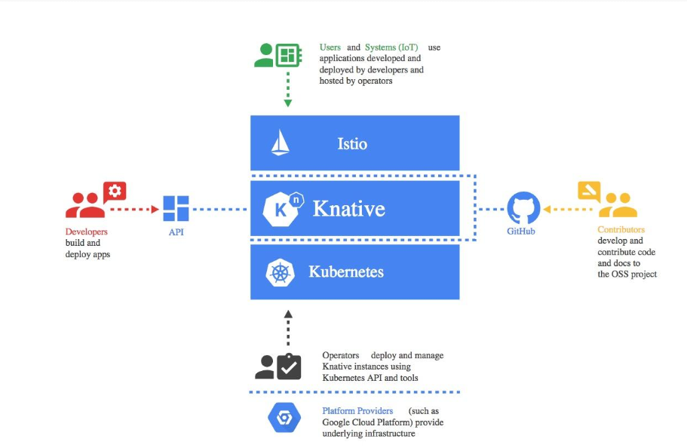
What is Knative
Knative based on Kubernetes, Istio and other components which created by Google, Pivotal, SAP, Red Hat, IBM, and many others contributors.

Slide 3
What is Knative
Knative extends Kubernetes to provide a set of middleware components that are essential to build modern, source-centric, and container-based applications that can run anywhere: on premises, in the cloud, or even in a third-party data center.
Knative adds three loosely-coupled components to provide a complete serverless platform: Build, Eventing, and Serving.
Build provides a pluggable model for building containers from source code.
Eventing allows apps/functions to publish to, and subscribe to, event streams such as external events, internal events, Google Cloud Pub/Sub, Apache Kafka and others.
Serving provides the ability to easily run applications/functions and scale them up or scale them down to zero.

Slide 4
Knative Build
A Build is a custom resource in Knative that allows you to define a process that runs to completion and can provide status. For example, fetch, build, and package your code by using a Knative Build that communicates whether the process succeeds.

Slide 5
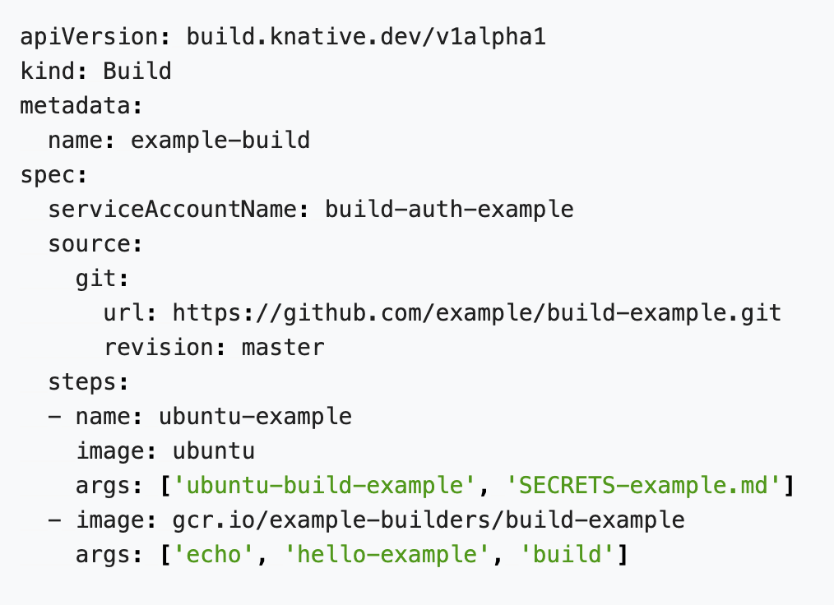
Knative Build
● A Build can include multiple steps where each step specifies a Builder.
● A builder is a type of container image that you create to accomplish any task, whether that’s a single step in a process, or the whole process itself.
● The steps in a Build can push to a registry.
● A BuildTemplate can be used to defined reusable templates.
● The source in a Build can be defined to mount data to a Kubernetes Volume, and supports:
- git repositories
- Google Cloud Storage
- An arbitrary container image
● Authenticate with ServiceAccount using Kubernetes Secrets.

Slide 6
Knative Eventing
Knative Eventing is a system that is designed to address a common need for cloud native development and provides composable primitives to enable late-binding event sources and event consumers.
● A Broker provides a bucket of events which can be selected by attribute. It receives events and forwards them to subscribers defined by one or more matching Triggers.
● A Trigger describes a filter on event attributes which should be delivered to an Addressable. You can create as many Triggers as necessary.

Slide 7
Knative Eventing
Knative Eventing is a system that is designed to address a common need for cloud native development and provides composable primitives to enable late-binding event sources and event consumers.

Slide 8
Knative Serving
Knative Serving provides the ability to easily run applications/functions and scale them up or scale them down to zero.
● Service – resource which automatically manages the whole lifecycle of your workload.
● Route - maps a network endpoint to a one or more revisions.
● Configuration - maintains the desired state for your deployment. It provides a clean separation between code and configuration and follows the Twelve-Factor App methodology. Modifying a configuration creates a new revision
● Revision - is a point-in-time snapshot of the code and configuration for each modification made to the workload. Revisions are immutable objects and can be retained for as long as useful.

Slide 9
Pipelines

Slide 10
Knative installation
Knative requires a Kubernetes cluster v1.11 or newer.
Comprehensive install guides:
Azure Kubernetes Service
Gardener
Google Kubernetes Engine
IBM Cloud Kubernetes Service
IBM Cloud Private
Minikube
Pivotal Container Service
.
Limited install guides:
Docker for Mac
Minishift
OpenShift
Operator
Alpha:
Install on any Kubernetes

Slide 11
Knative demo

